Slide 1
Presentation of equipment.

Slide 2
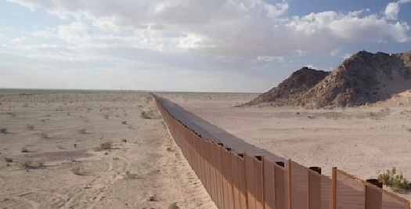
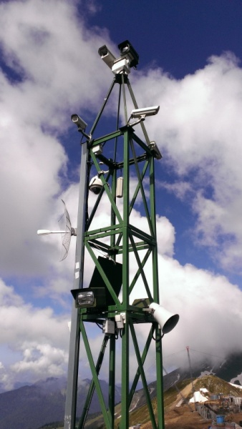
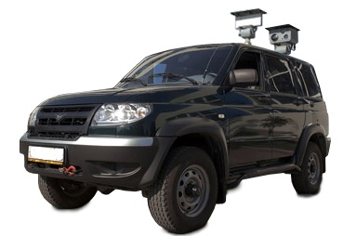
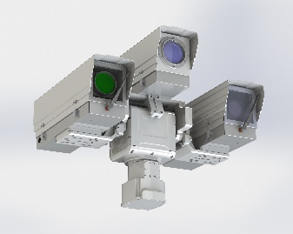
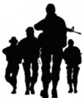
1. State border surveillance
up to 20 km.
up to 9 km.
up to 15 km.
up to 9 km.

Slide 3
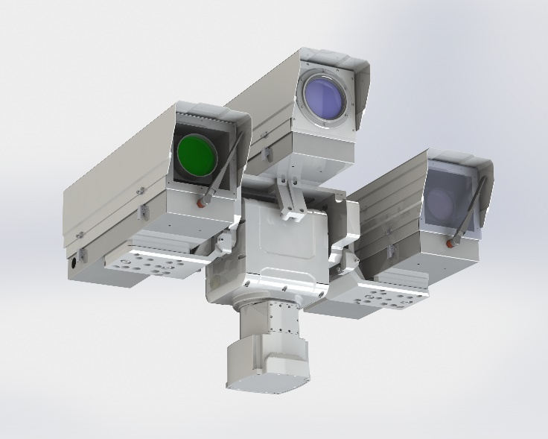
1.1. Stationary thermal-imaging equipment
Designation:
24 x 7 area surveillance under any weather conditions;
detection of potentially hazardous target;
assessment of object movement;
ensuring early response to potential threat;
prevention of unauthorized perimeter crossing.
Functionality:
The detection range of our thermal imagers can reach 20 km enabling to react promptly to and prevent any potential threat.
Thermal imagers can be operated under any lightning conditions, even in total darkness. They are resilient to any light sources, i. e. it is impossible to “blind thermal imager” as it may happen with night vision devices.
Stable operation under adverse weather conditions is also ensured by special and additional devices (radar, seismic, oscillating, etc.).
Patterns of interaction between thermal imagers and other devices are developed individually to ensure maximum operational effectiveness of the whole complex.

Slide 4
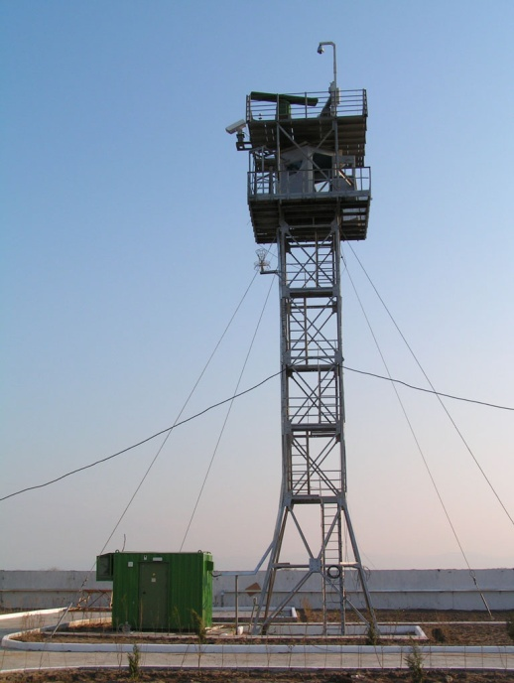
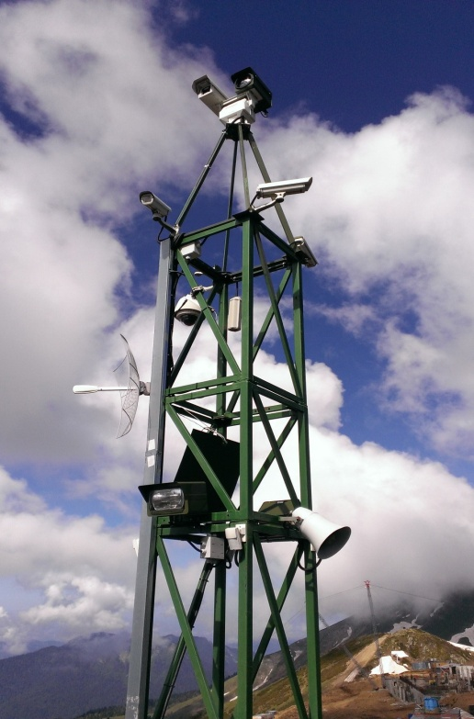
1.2. Radar-thermal imaging station for remote control
Designation:
24 x 7 visual and radar control over land, surface and air situation, including long-range detection of different still or moving targets. Station is absolutely autonomous and does not require industrial electrical network or construction of communication lines.
Radar-thermal imaging station for remote control is used for the following purposes:
real-time intelligent video surveillance in wide open areas;
auto detection and tracking of targets by means of pan-tilt video camera and thermal imager – operation in video location mode;
ensuring station security;
autonomous power supply based on solar and wind energy;
setting communication channel with remote monitoring station.
Application field:
Station is used for ensuring security of open areas and perimeters, approaches and routes towards important facilities that are far from station posts and is designed to serve as the basic or support line of security.

Slide 5
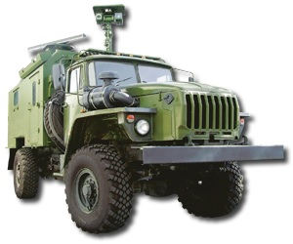
1.3. Mobile control stations installed on all-terrain vehicle
Designation :
Surveillance of unprepared area sites (long borders, temporary camps, etc.).
Functionality:
auto detection, recognition and tracking of targets by means of thermal imagers and video cameras under adverse weather conditions;
continuous automatic documenting of controlled environment;
operation as a part of automated technical control systems, including real-time information output;
covert movement of vehicle with the switched off headlights at night while using night driving systems;
movement across rugged terrain under any weather conditions.
Mobile control station may include:
radar unit;
long-range optical electronic module;
all-terrain vehicle;
communication and data transfer complex;
autonomous power supply system;
personal security system;
automated workstation.
passenger car
auto-truck

Slide 6
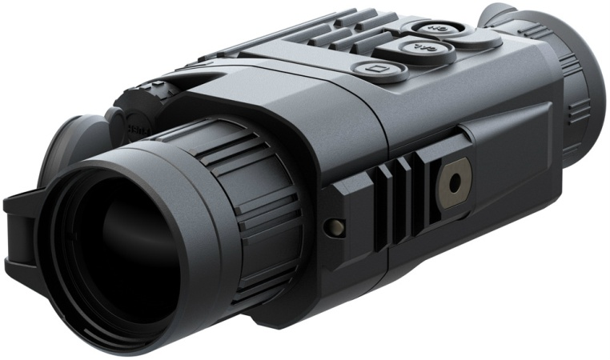
1.4. Portable thermal-imaging equipment
Designation :
This equipment is used for performing search and rescue operations, detecting targets, protecting representatives of law enforcement bodies, 24 x 7 monitoring of people and machinery location and movement under any weather conditions, detection of hidden and camouflaged objects on wide sites, performing covert surveillance, pursuing fugitives, ensuring safety of military personnel.
Advantages:
handy use in the field;
possibility to perform surveillance under all environmental conditions: in the presence of dust or smoke, in total darkness, avoiding image defocusing when external light sources appear.
Characteristics:
small size, high-strength;
quick focusing;
photo- and video recording;
high sensitivity;
operating temperature — from -30 °C to +60 °C;
flotation — does not sink;
human detection range from 2.0 km to 7.2 km. (depending on the version);
vehicle detection range from 3.0 km to 9.0 km. (depending on the version).

Slide 7
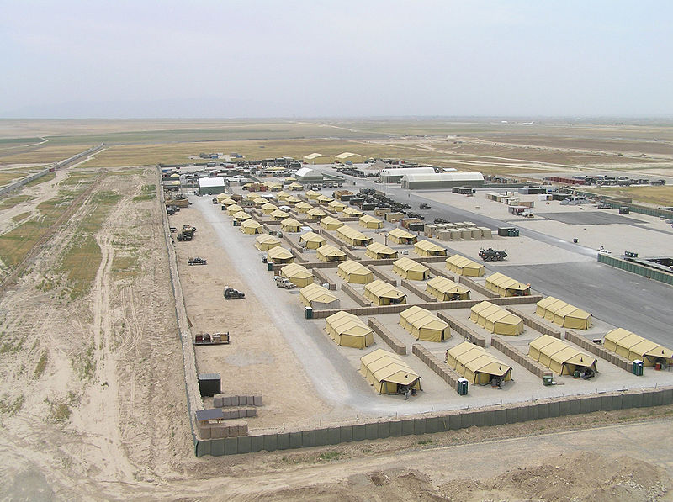
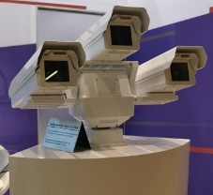
2. Surveillance of particularly important facilities
up to 100 km.
up to 9 km.
up to 15 km.

Slide 8
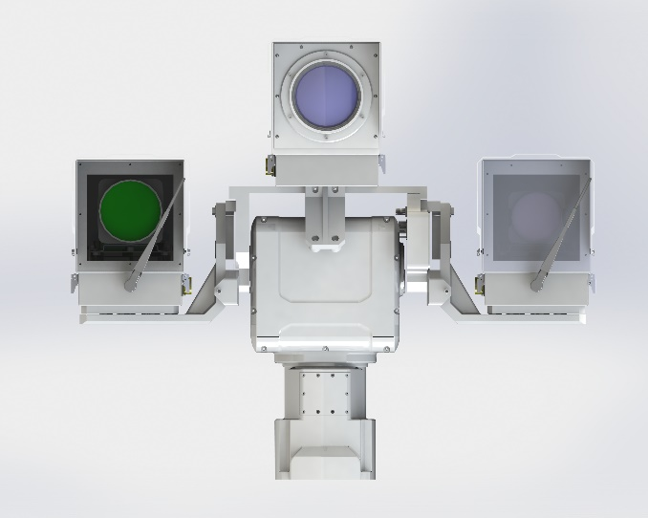
2.1. Stationary thermal-imaging equipment
Designation:
24 x 7 area surveillance under any weather conditions;
detection of potentially hazardous target;
assessment of object movement;
ensuring early response to potential threat;
prevention of unauthorized perimeter crossing.
Stationary thermal-imaging equipment for perimeter protection can be used together with other means of detection (vibration, radar, etc.); It can be used for protection of water surfaces adjacent to the protected area;

Slide 9
2.2. High contrast camera
High contrast camera is used to detect and identify small and ultra-small targets (for example, UAVs). This device can be used both independently and as a part of optical location complex.
Function:
Camera operation algorithm is passive and does not have signature unlike any other radar systems. Use of spaced cameras for achieving stereo effect ensures precise determination of coordinates and distance to the object under surveillance which allows cameras to be used as target designation for the air defense systems.
Application field:
UAV detection (up to 15 km – small UAVs, up to 25 km – medium-sized);
detection of satellites and aircrafts;
detection of cruise missiles and ballistic missile warheads;
surveillance in conditions of fog, smoke or created smoke screens.

Slide 10
2.3. Portable thermal-imaging equipment
Benefits:
ultra-high sensitivity;
outbound observation;
clear image;
the optical field of view of binoculars;
fast autofocus;
electric focus;
the ability to capture photos and video; remote control.
Portable thermal-imaging equipment is highly effective all-weather day and night surveillance. Designed to protect critical facilities, exploration, night patrols, covert surveillance and tracking. The housing is made of impact-resistant thermal plastic obrezinena and protected from external influences. Easy to use.

Slide 11
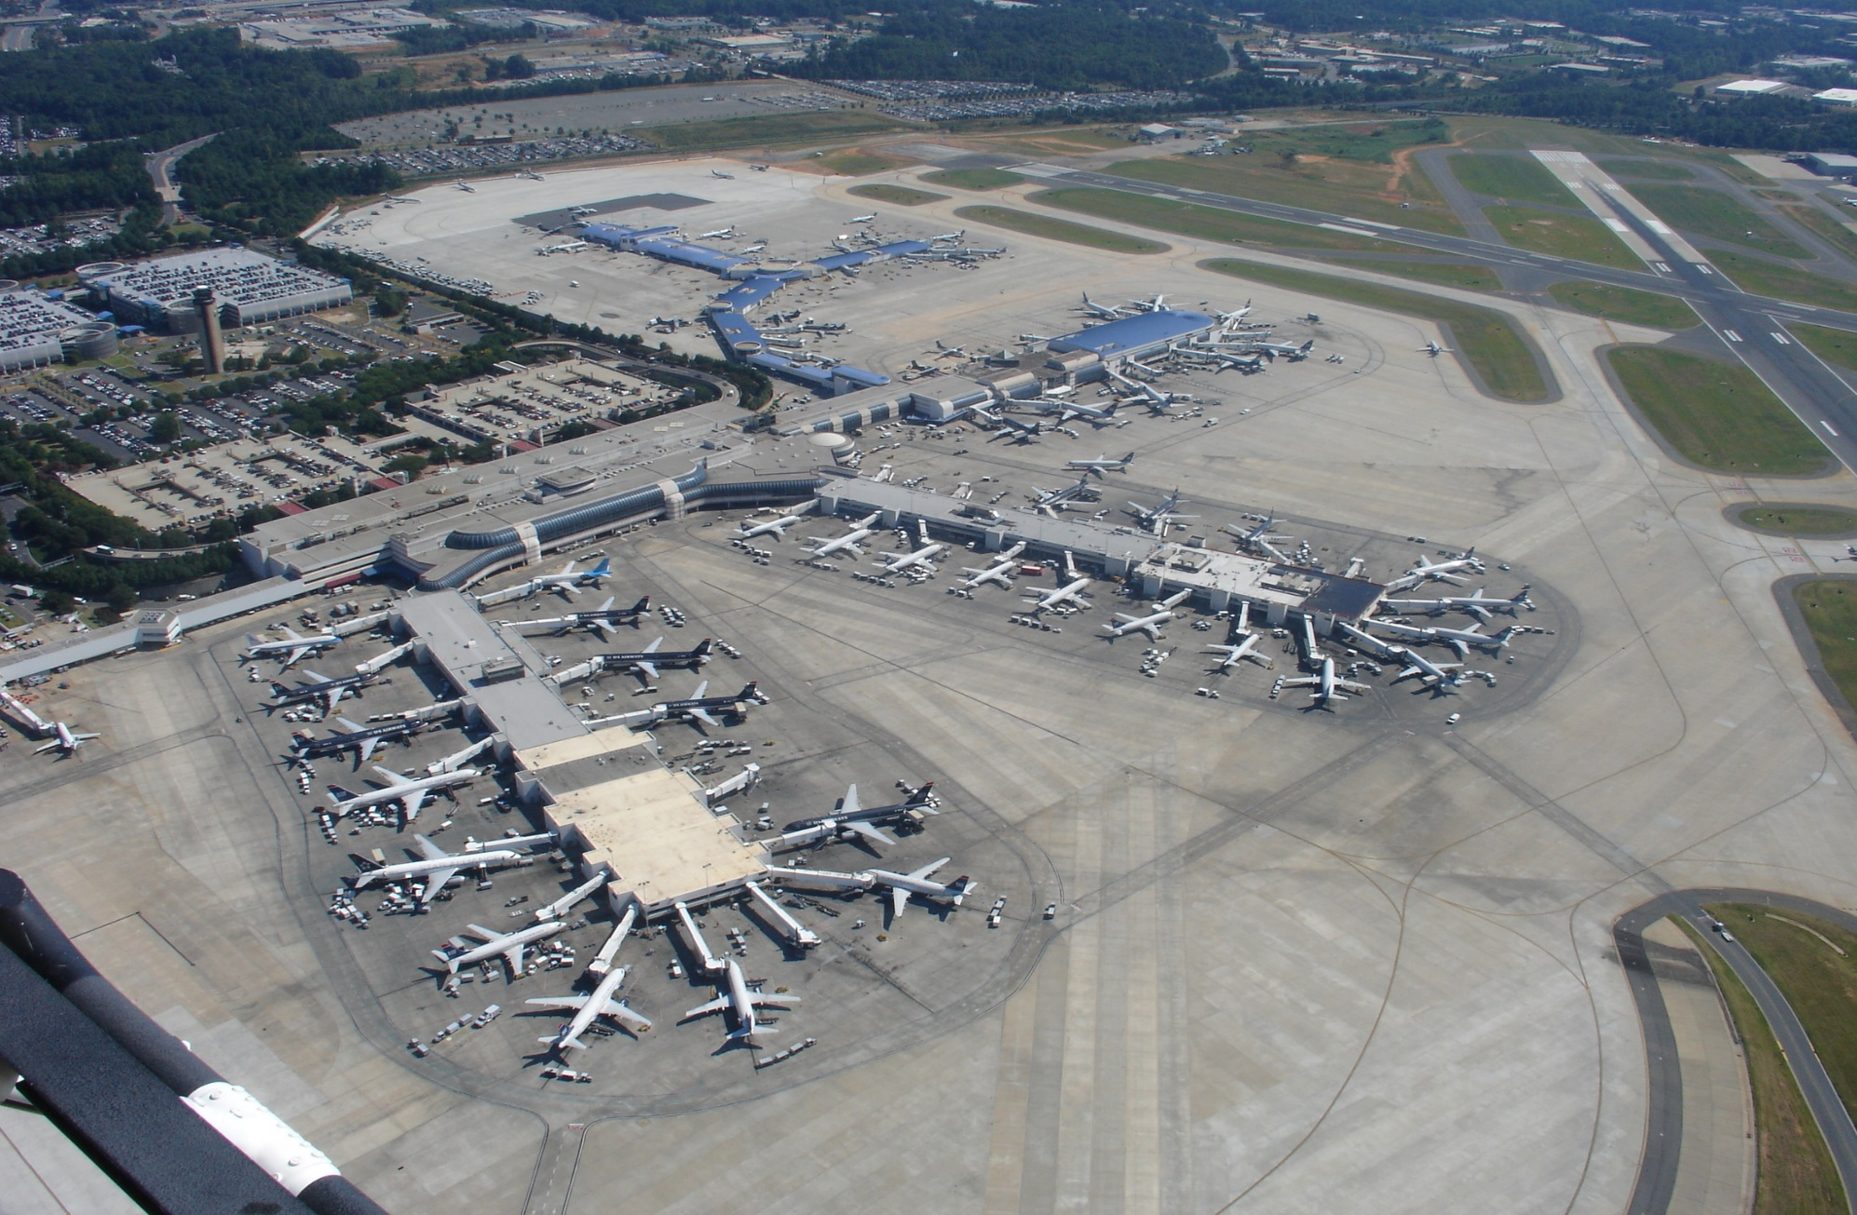
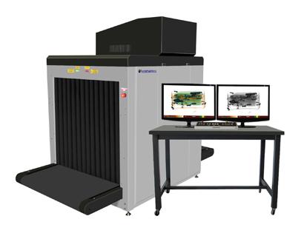
3. Airport surveillance
up to100 km.
up to 100 km.
up to 9 km.
up to 15 km.

Slide 12
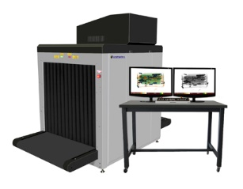
Airport surveillance :
use of stationary thermal-imaging equipment along with other detecting devices to ensure security of long perimeters ;
use of portable thermal-imaging equipment by patrol forces;
use of radar-thermal imaging stations to ensure remote control over airfields;
use of low contrast cameras to detect UAVs and birds;
arrangement of airport access and checking systems.

Slide 13
4. Port surveillance
up to100 km.
up to 9 km.
up to15 km.

Slide 14
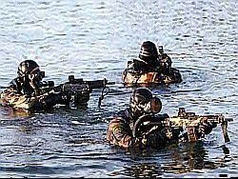
Port surveillance :
use of stationary thermal-imaging equipment along with other radar devices to ensure security of waters neighboring sites under surveillance, as well as security of anchorages;
using sonar and magnetometer systems to detect frogmen and saboteurs;
use of portable thermal-imaging equipment by patrol forces;
use of low contrast cameras to detect UAVs.

Slide 15
Thank you for your attention!

