Slide 1
ArMAW Armaturen GmbH
Valve-engineering for future
decisions for localization of the leading world technologies
Wife in your t
Berlin, 2017

Slide 2
About company
Armaw Armaturen GmbH is the one of worlds leading
of valve design and engineering
Valve engineering services from 2000
Long-term engineering services
Support of the organization of manufacture
Recommendations about the choice of the equipment
More then 15 valve-manufacture in the world using our technologies.
Armacon Systems GmbH (Germany), Armasus GmbH (Germany), Magwen valves GmbH (Germany), Zwick Armaturen (Germany), Muller COAX (Germany) are working with our technologies now.
We will provide you the level of technologies for the successful competition with OHL, Adams, Krombach, Shuck, Samson, Tyco, Mokveld, Vanessa, Fisher, Bomafa, KOSO, HORA, Masoneilan , CCI, Bopp&Reuther, Daume.

Slide 3
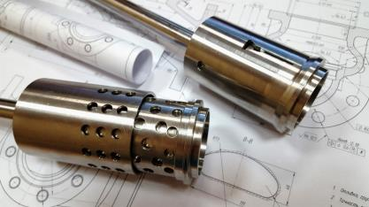
Design structure
We are using the newest programs,
3-D models PDM CAD CAM ANSIS master CAM.
Our design departments:
for control valves
for special valves with high parameters (for Power Station and Nuclear station)
For oil and gas industries

Slide 4
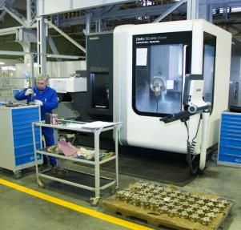
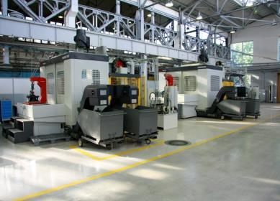
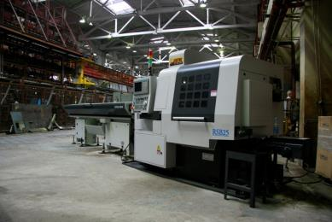
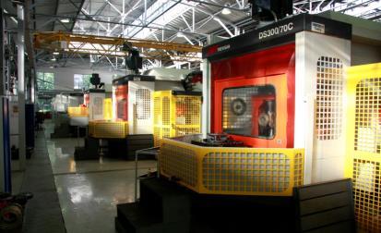
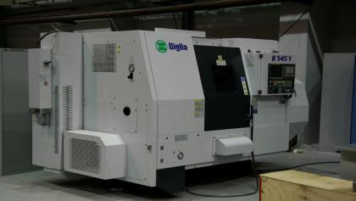
Recommendation on equipment selection

Slide 5
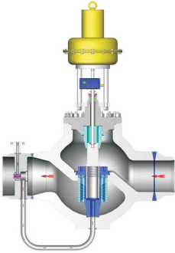
ADVANSED PRODUCT DESIGN valve in critical application
- Solutions for Power and Nuclear Station (Turbine Bypass Systems, steam redusing and conditioning valves, heater bypass system, recirculation system (on/off or modulating) choke valves, valve maintenance and repair overhaul of complete systems PN till 800 bar
These types of product are successfully operated on objects of Germany, Saudi Arabia, Russia, Trinidad and Tobago

Slide 6
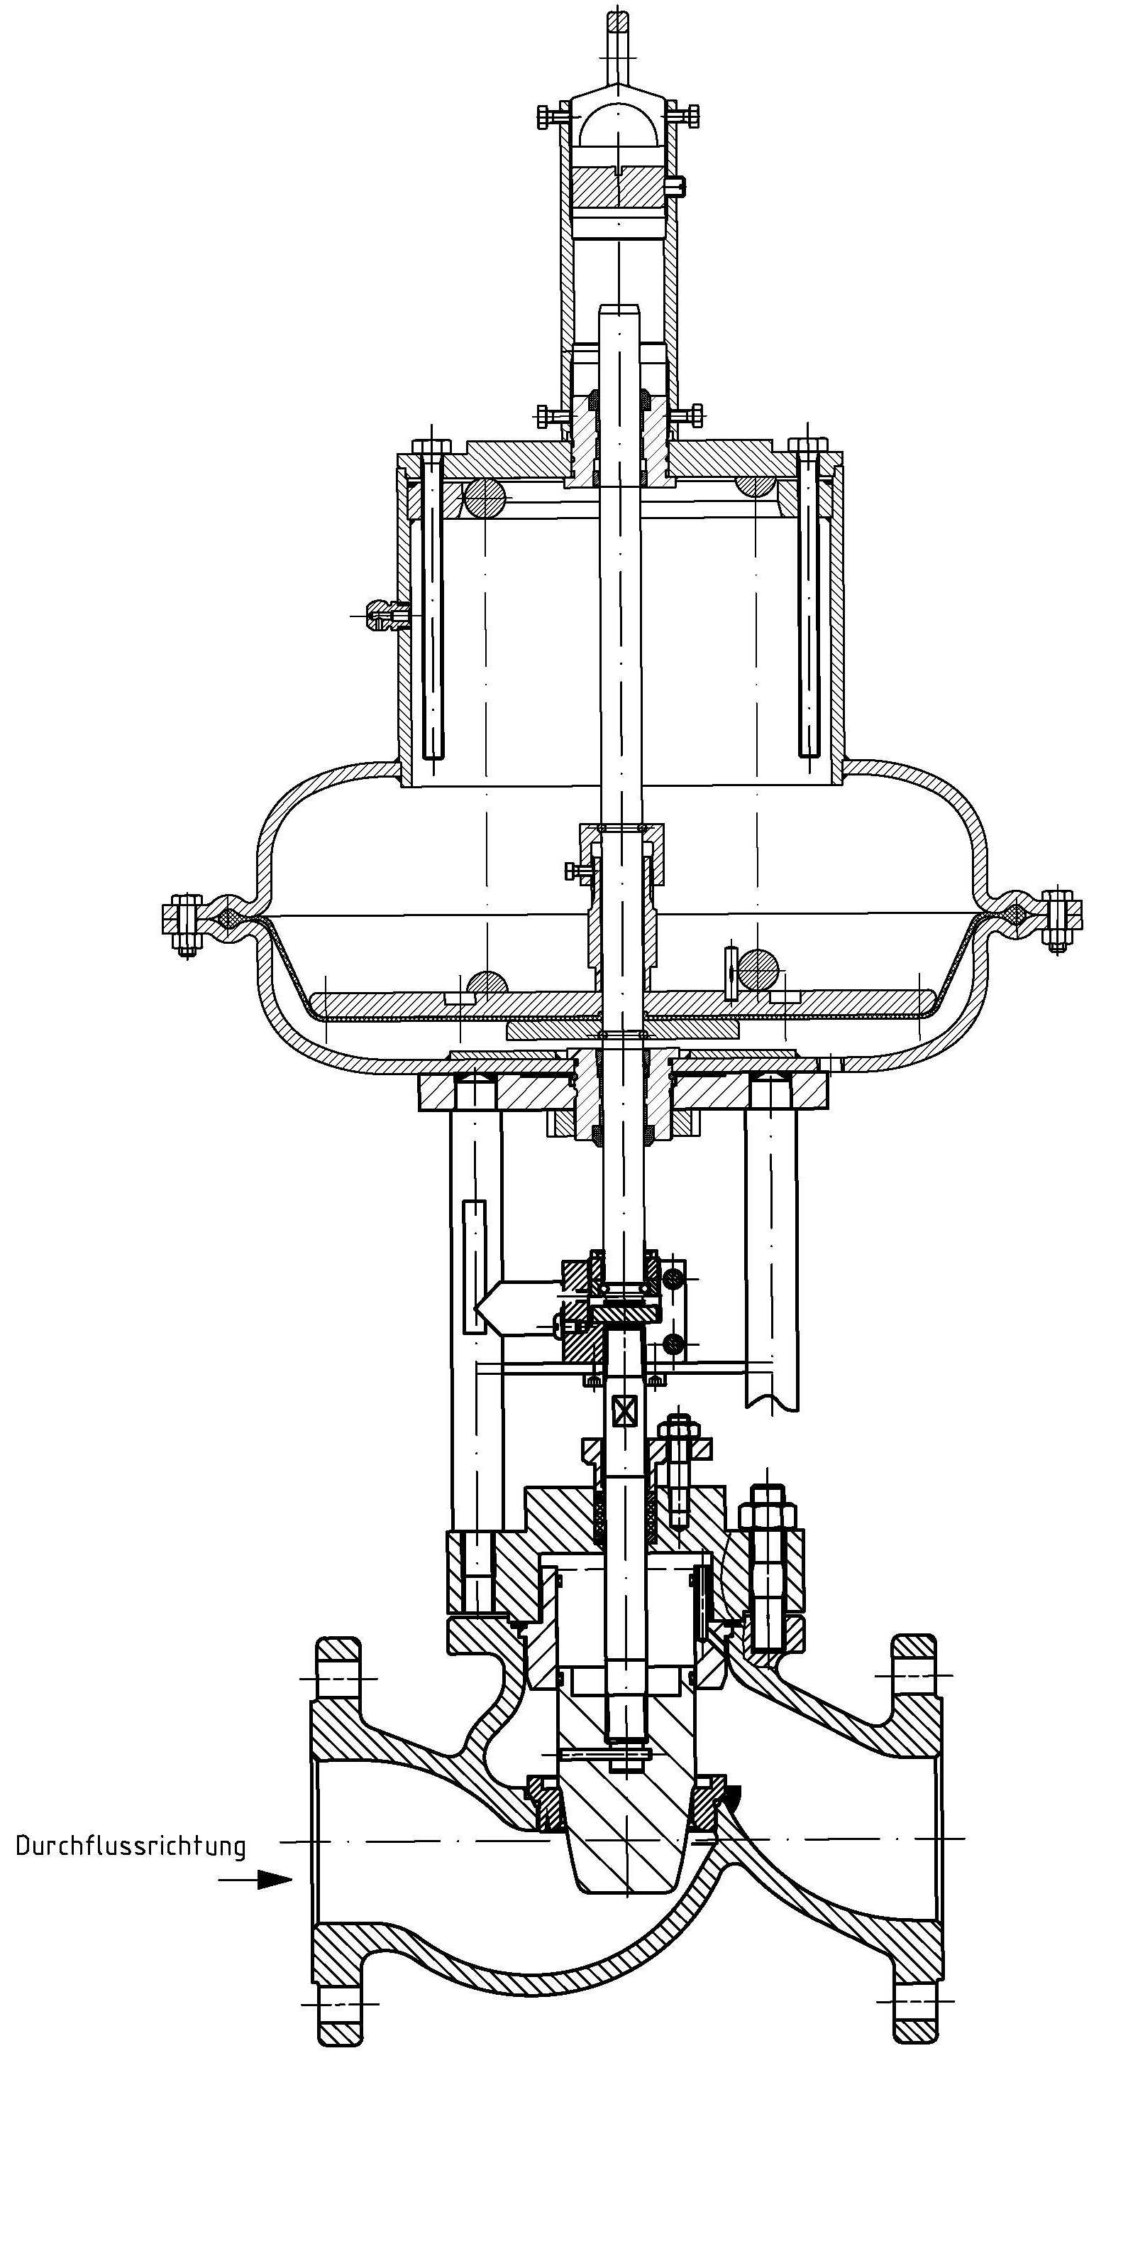
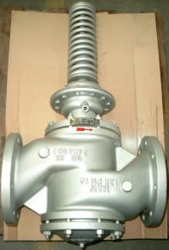
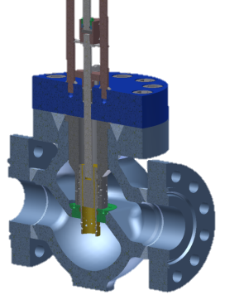
Main products
- Control valves anti-cavitational, noise suppression. Individual valves under specific conditions of exploitation).
DN 15 – 300 mm, PN 10 – 400 bar

Slide 7
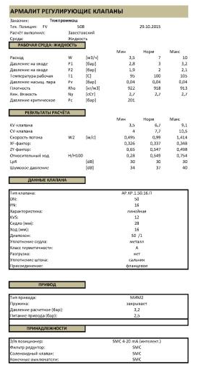
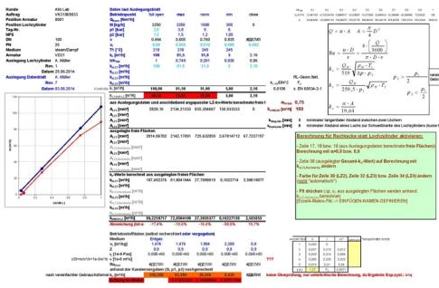
Personal valve construction and calculation
Results of calculation
Construction the running part of the valves according to the client

Slide 8
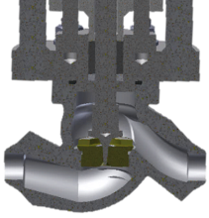
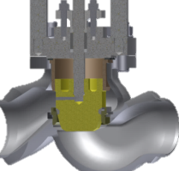
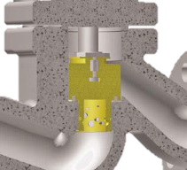
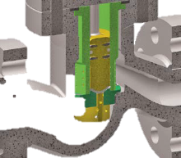
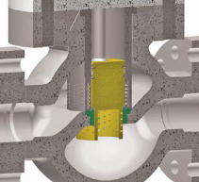
Different construction of the control valves
Solutions for high pressure differences
Designs for anti cavitation and noise reduction
Precision flow control
Plunger with perforated cilinder
«micro flow»
Parabola plunger
Plunger for anti cavitation with
1 step
Plunger for anti cavitation with
2 step
Plunger for anti cavitation with
3 step

Slide 9
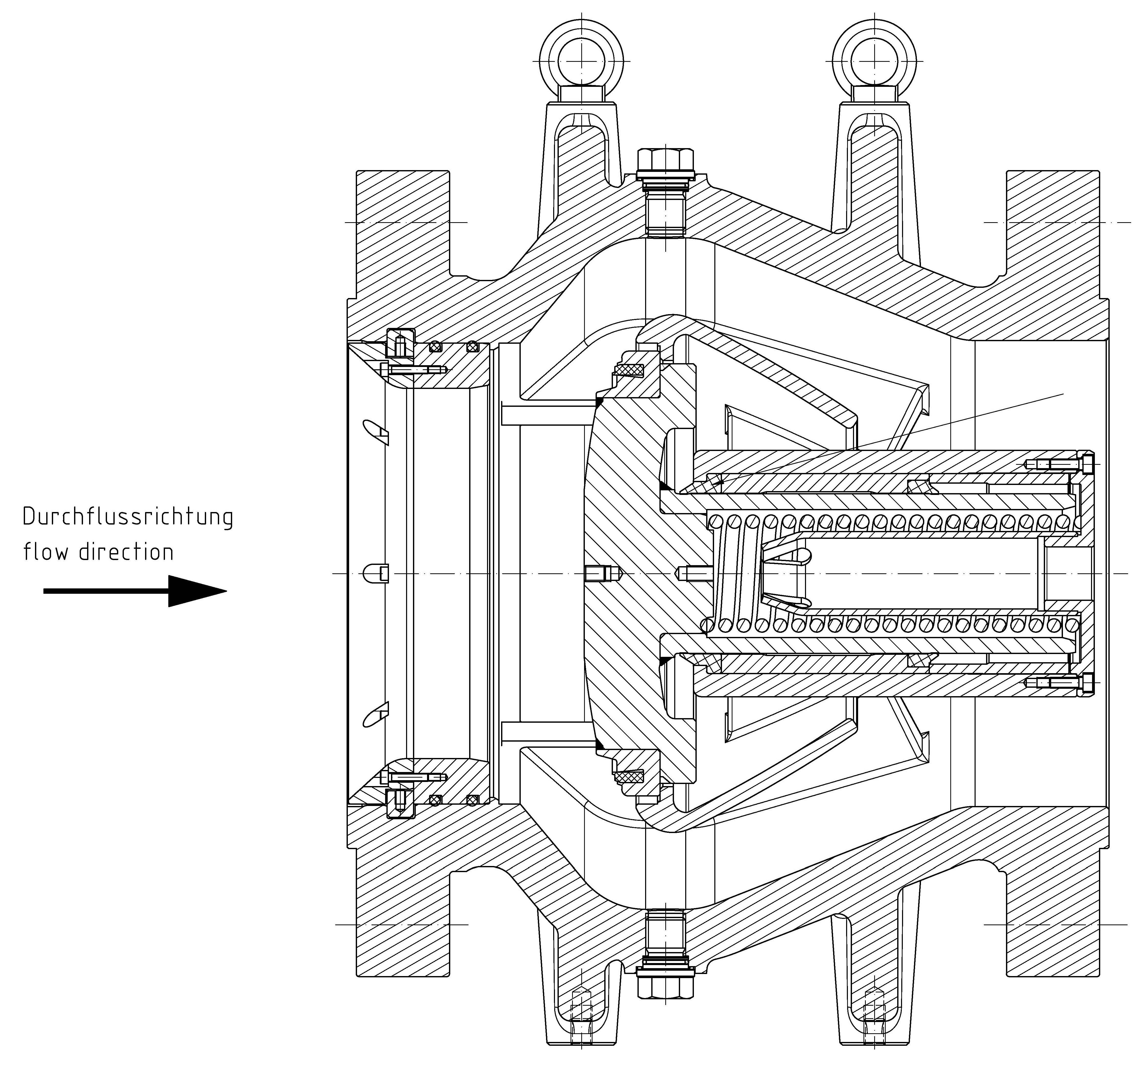
Main products
Non slam nozzle check valve Are actively applied in system of the gas distribution lines
DN 150 – 2000 mm, PN 1 – 16 bar

Slide 10
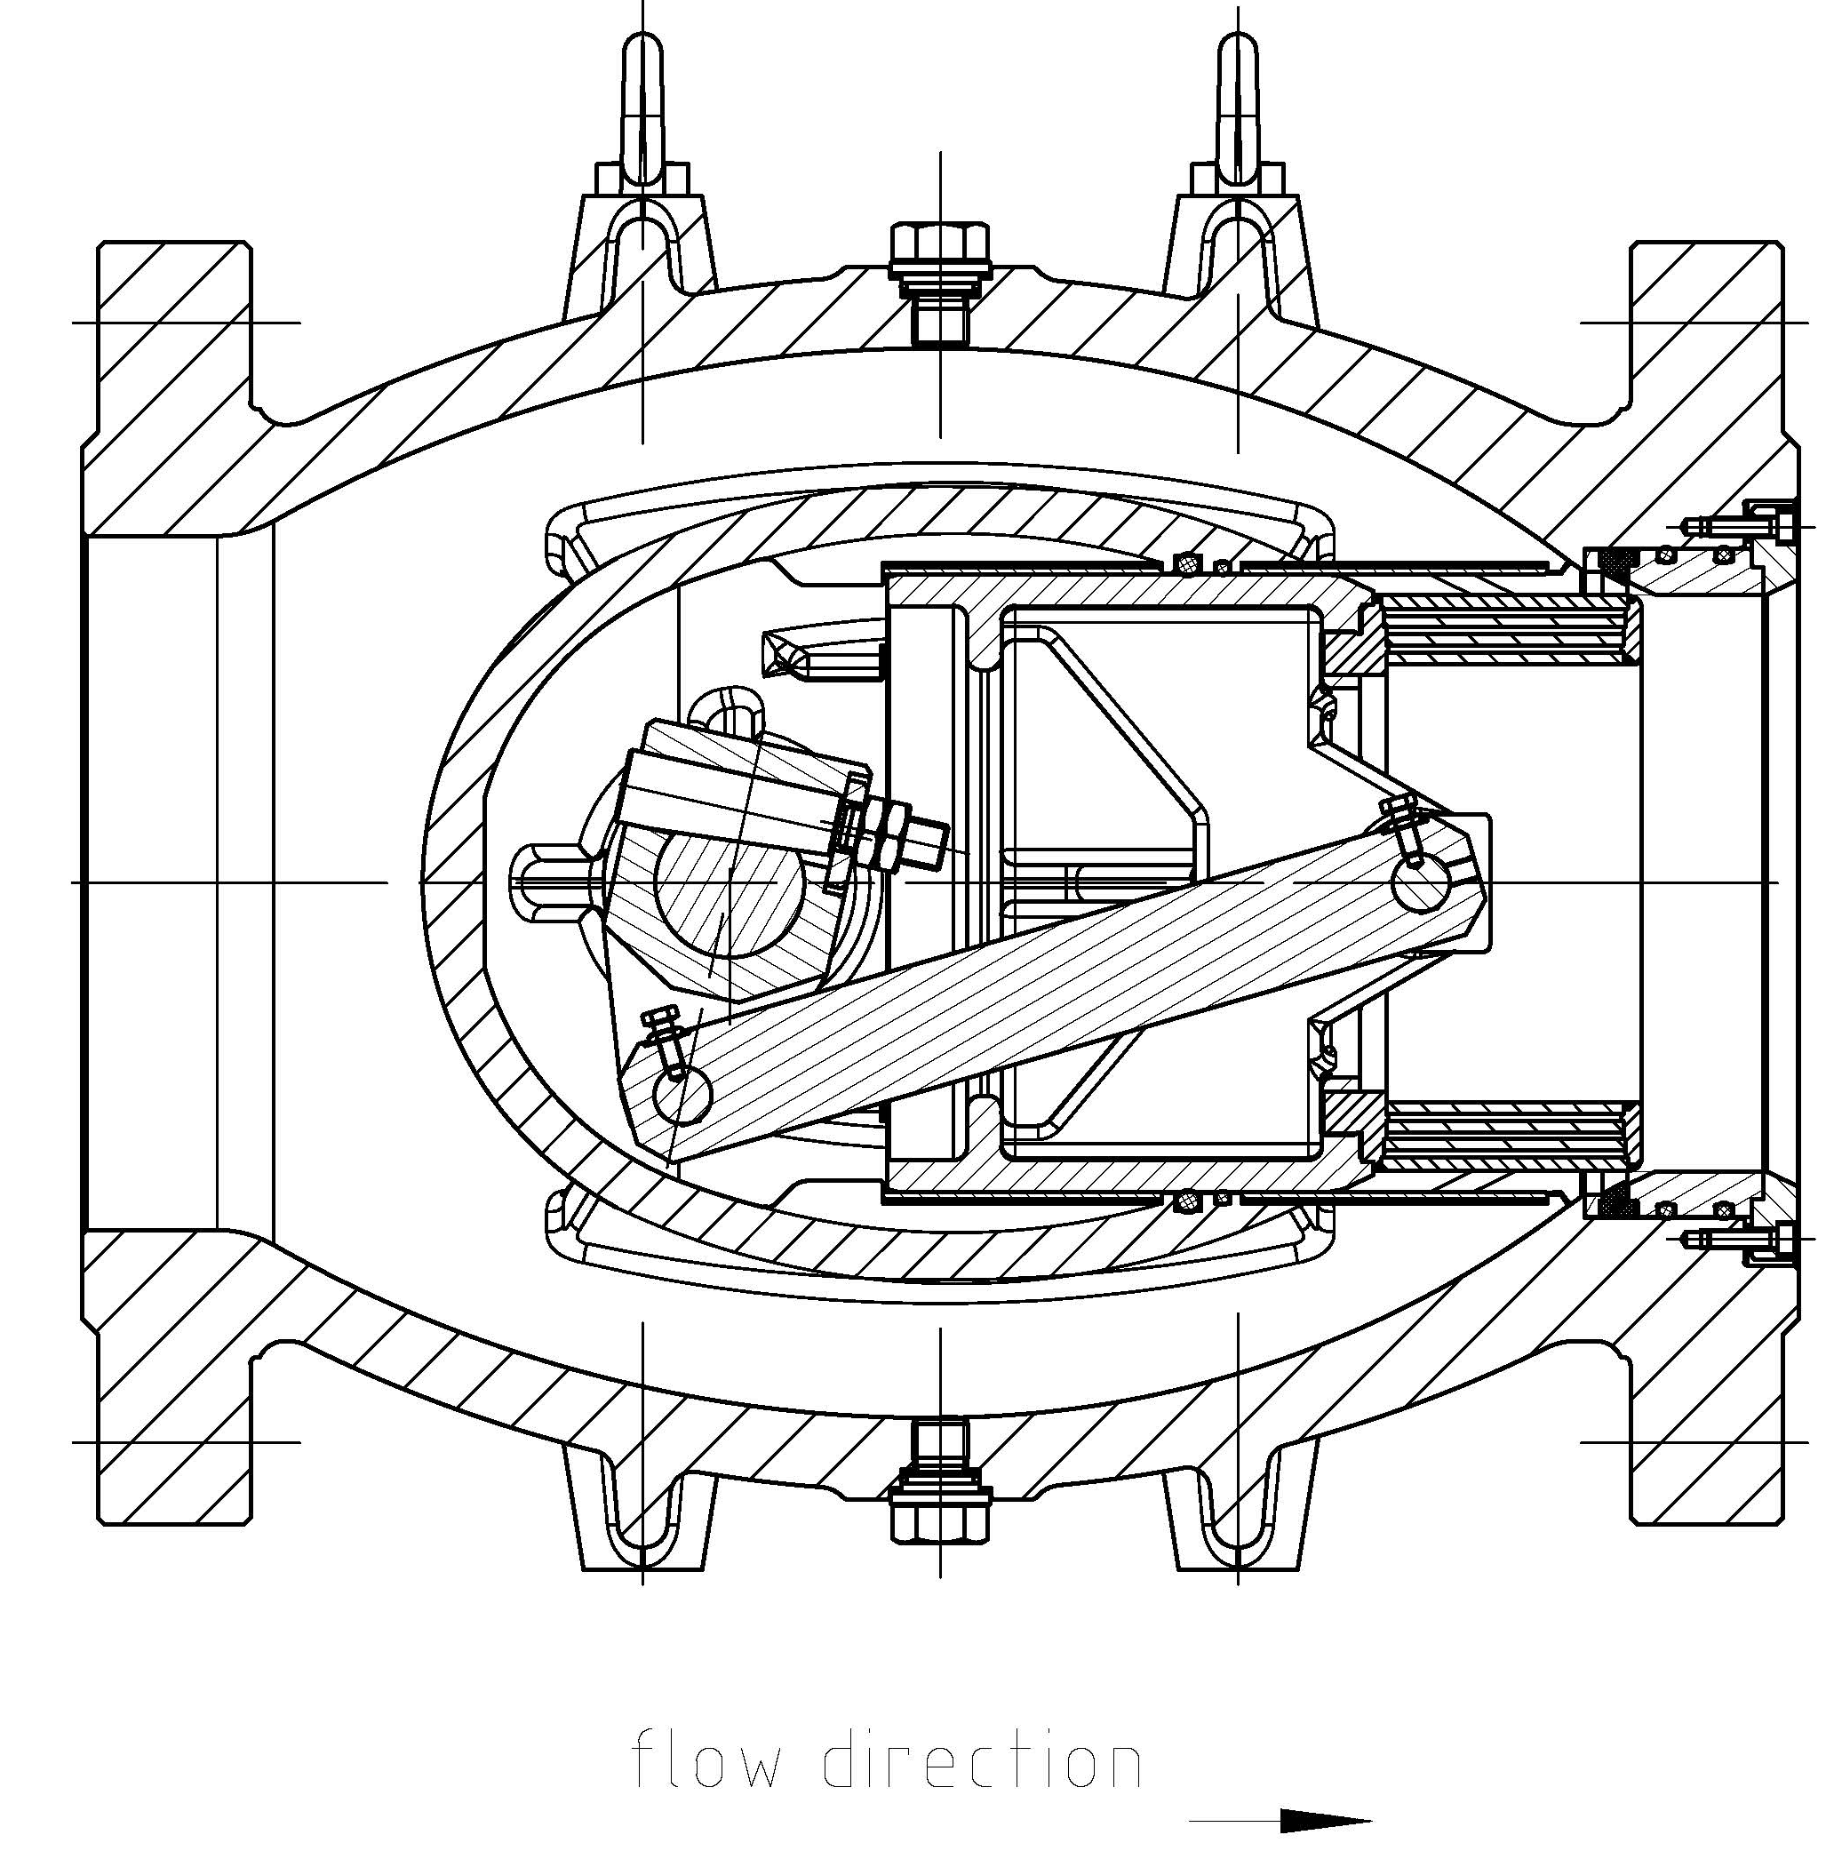
Main products
Plunger valves It is applied for antisuge of devices on annual pipelines, as the control valve. the main competitor - "Mokveld" Holland
DN 50 – 2000 mm, PN 10 – 250 bar

Slide 11
Short range
ArMAW Valves
 | Product | Type | PN |  | DN |  |  | Body |  |  |  |  |  | Connection type |  |  |  |  | Actuator
 |  |  | min | max | min | max |  | cast iron | carbon steel | high-temper. steel | low temper. Steel | stainless steel |  | flanged ends | Welded ends | Luge type | Wafer type |  | Handwheel | Electric | Pneumatic | Hydraulic
Shut-off | Butterfly valve | ABS | 16 | 40 | 50 | 2400 |  | + | - | - | - | - |  | + | - | + | + |  | + | + | + | +
 |  |  | 16 | 400 | 50 | 1200 |  | - | + | + | + | + |  | + | + | + | + |  | + | + | + | +
 | Segment-valve | ATS | 16 | 40 | 50 | 2000 |  | + | - | - | - | - |  | + | - | - | - |  | + | + | + | +
 |  |  | 16 | 400 | 50 | 1200 |  | - | + | + | + | + |  | + | + | - | - |  | + | + | + | +
 | Non-slam nozzle check valves | ADR | 16 | 40 | 80 | 1600 |  | + | - | - | - | - |  | + | - | - | - |  | - | - | - | -
 |  |  | 16 | 160 | 80 | 1600 |  | - | + | + | + | + |  | + | + | - | - |  | - | - | - | -
Control valves | Butterfly valve | ABC | 16 | 40 | 50 | 2400 |  | + | - | - | - | - |  | + | - | + | + |  | + | + | + | +
 |  |  | 16 | 400 | 50 | 1200 |  | - | + | + | + | + |  | + | + | + | + |  | + | + | + | +
 | Segment-valve | ATC | 16 | 40 | 50 | 2000 |  | + | - | - | - | - |  | + | - | - | - |  | + | + | + | +
 |  |  | 16 | 400 | 50 | 1200 |  | - | + | + | + | + |  | + | + | - | - |  | + | + | + | +
 | Plunger valve | ARV | 16 | 40 | 100 | 2000 |  | + | - | - | - | - |  | + | - |  | - |  | + | + | + | +
 |  |  | 16 | 160 | 100 | 2000 |  | - | + | + | + | + |  | + | + | + | + |  | + | + | + | +
 | Control valve (straight, angle) | AVD, AVE | 16 | 25 | 15 | 300 |  | + | - | - | - | - |  | + | - | - | - |  | + | + | + | +
 |  |  | 16 | 400 | 15 | 300 |  | - | + | + | + | + |  | + | + | - | - |  | + | + | + | +

Slide 12
Processes of collaboration
The choice of the interesting nomenclature
Contract details discussion
Signature of the Joint Venture contract
Determination of a prototype
Provision of documentation on a sample manufacture of the prototype on your own capacities or in cooperation
Testing of the prototype
Transfer of a set of documentation on all chosen number of products
Maintenance of statement on serial production
Personnel training
Consultations for optimization of production and decrease of cost value

Slide 13
Contact information
Sales and marketing department
+7(905) 222-42-59
info@armaw.de
www.armaw.de

Slide 14
Thank you for your attention

