Slide 1
EVT Anlagenbau GmbH, Wien
A.Ulanov, S.Baru
The Systems of x-ray control with micro doses of x-ray radiation – an optimum instrument for ensuring of safety of air passengers
2016 г.

Slide 2
Control of passengers at the airport includes:
Identification of the personality.
Examination of hand luggage and baggage.
Personal examination of people.
Technical means for implementation of the first two points have reached high level. On the contrary, means of personal examination, as of today, are very primitive. Therefore, the existing system of personal examination based on metaldetectors, an undressing, release from footwear and delicate palpation
doesn't correspond to modern "technologies" of terrorists:
has low detective ability;
it is humiliating and tiresome for both parties;
demands a large number of personnel;
has low capacity.
demands expendables (boot covers) and the additional equipment (manual metaldetectors, trays for clothes and footwear).
The problem has ripened and the system of examination should be changed cardinally.

Slide 3
Purpose of examination of the person: detection of any suspicious (including nonmetallic) objects and substances which availability is illegal and people tries to hide them. The possibility of examination and in special cases has to be provided: the person with an artificial limb, in plaster, etc.
Such examination has to be:
Effective, i.e., an opportunity has to be provided
detection of suspicious low-contrast objects in any
the place – on a body, in a body, in clothes, in footwear. Has to be high
spatial resolution in details to consider these
objects and their internal structure.
Safe for checked, people around and personnel. At
use of any radiation the dose has to be ultralow, even
in comparison with a natural background. Radiation background around
the background around a luggage introscope shouldn't exceed installations.
Bystrym, to provide high capacity.
Time of inspection shouldn't exceed several seconds.
Not to bring discomfort and not to be humiliating.

Slide 4
By the present moment two main solutions have appeared:
The installations "feeling" a surface of the person a narrow beam (radio waves or X-ray) and registering the reflected (scattered) radiation. Lack of such decision: under dense clothes, in footwear and in natural cavities of a body nothing is visible. The person has to take off outerwear, footwear, a belt and to strike pose when examination of the closed places of a surface of a body is possible (between legs, an armpit). Examples – SafeScout 100 (USA), Secure 1000 (USA).
The installations using the getting radiation. At the same time the person doesn't need to undress, be undressed, take off a belt. It is possible to stand in a "free" pose. At the same time there are no places hidden for examination, even in a body. Examples – SRK (Russian Federation), B-Scan(Smith Detection).
Popular belief that the "feeling" installations are harmless, and installations with the getting radiation cause damage to health as surveyed receives some dose of radiation. It is meanwhile obvious that only installations with the getting radiation can provide effective and convenient examination. Just for their application it is necessary to make this dose such that it was negligible, even in comparison with a natural natural background.

Slide 5
The existing systems of personal examination
Parameters of installations practically of all producers of customs systems - CJSC SIEBEL, by Smith Detection, LLC SKB Medrentekh, Borlas Security Systems, ADANI (Not lx), TSNK, CJSC Nauchpribor, Nuctech, Rapiscan, DEBTECH, INPTs "SNK" of MSTU of MIREA have been studied.
The characteristics reflecting properties of installations of various principle of action are given below.
HOMOSCAN,
VZOR-ТB
(Russia)
Conpass,
Consys
(Belarus)
Secure 1000
(USA),
Relief
(Russia)
SafeScout 100 (США),
eqoTM
_{(Smith Detection)}
B500,
B- Scan
(Smith Detection)
SRK (EVT Anlagenbu GmbH, Austria)
5

Slide 6
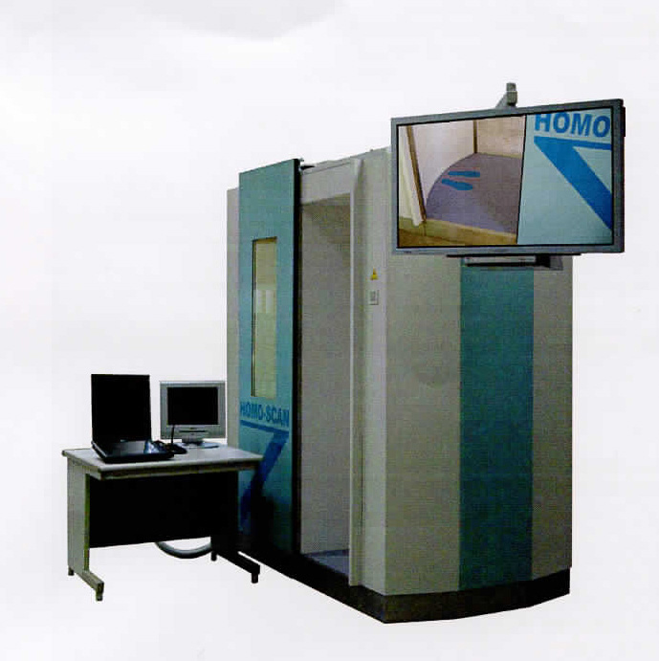
HOMOSCAN (Russia)
The system is based on use of the getting radiation
The size of the field of scanning - 2000х800.
Radiation dose - 0,3 - 1 μSv (on different sources)
Spatial resolution - 3 x 3 mm
Scanning time - 5 with
High noise level from scattered radiation that reduces quality of a picture
The direction of scanning - isn't optimum, the movement surveyed in time
emergence of artifacts in a picture can cause scannings.
Big geometrical distortions down in top and lower body.

Slide 7
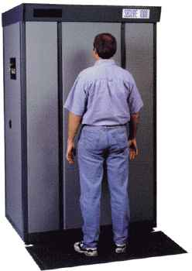
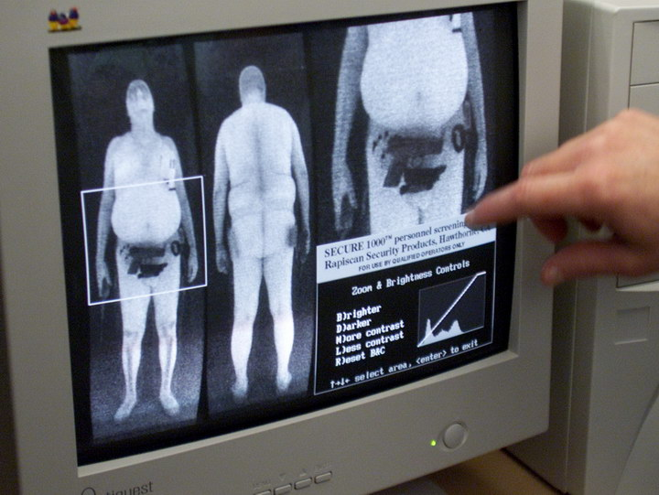
Secure 1000 (USA)
The person isn't appeared through, and "feel" his "surface" narrow
"pencil" beam of "soft" X-ray, in front and behind.
Dose – 0,1 μSv since there is no raying.
Scanning time ~ 8 with.
Permission ~ 5х5 mm.
The objects swallowed or hidden in natural aren't visible
body cavities.
Not clearly, how to look for something under dense outerwear or in
footwear,
i.e. it is necessary to remove them.
It isn't clear what to do in special cases (artificial limbs, plaster).
7

Slide 8
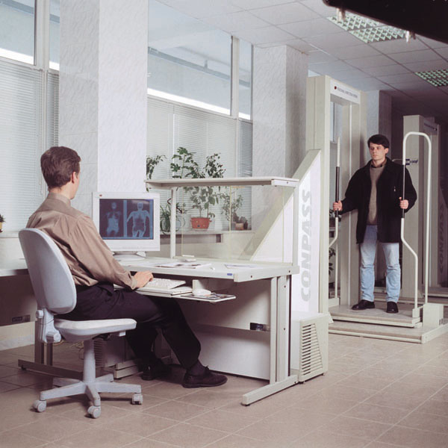
Conpass, Consys (Belarus)
The system works at the getting radiation.
The radiation dose – is unknown (from different descriptions – 0,4  3 μSv).
Inconvenient design with transportation of surveyed.
Scanning time ~ 12 pages.
Objects in footwear since the beam goes parallel to a sole are badly visible.
Big noise level from scattered radiation.
The non-optimal direction of scanning, therefore at "fluctuation" surveyed in
time of his transportation there can be artifacts on the image.
Big geometrical distortions down, especially in an upper body.
Only the operator is protected from the examined person of radiation disseminated in a body, other people aren't protected at all. Existence of a sanitary zone around installation where people can't be is required.

Slide 9
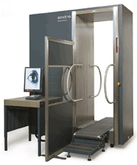
B500, B- Scan(Smith Detection)
By the principle of action and on design of system very reminds "Conpass".
The main shortcomings are kept – transportation surveyed, distortions down, the non-optimal direction of scanning, weak protection of people around against scattered radiation, big noise level. Inspection time – 7 seconds, the dose is specified not precisely – from 0,1 (!) to 2,0 μSv. Spatial resolution is unknown, noise and contrast sensitivity are unknown.
It is necessary to explain to everyone how it is necessary to rise on a moving path, for as how to keep hands how to descend from a path.
to be.

Slide 10
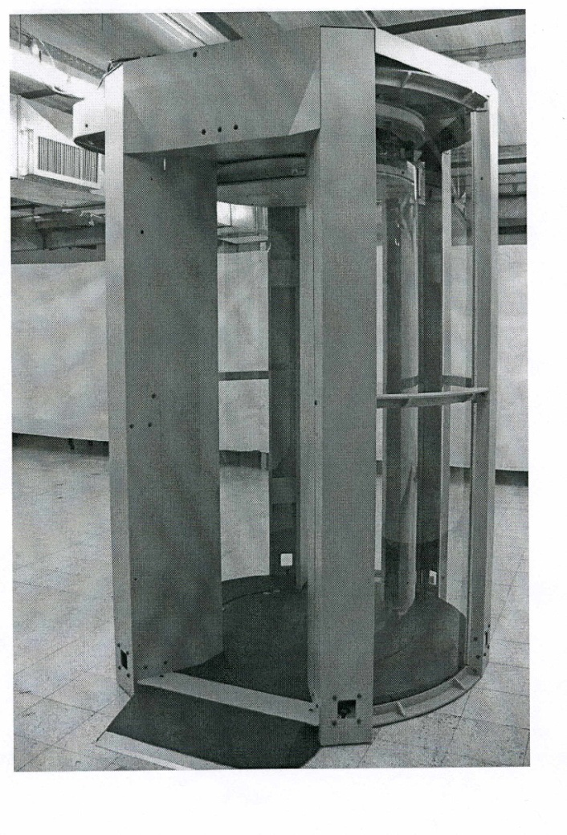
SafeScout (CША)
The system is based on radar scanning of a surface of the person (frequency of 24-30 GHz).
Safe Scout badly performs the main function (safety) as the objects hidden in natural cavities of a body or swallowed aren't visible.
Safe Scout reduces inconveniences and humiliation a little at examination: it is necessary to take off outerwear, a belt and footwear, and also to strike a discomfortable pose: legs are moved apart, hands are raised
Because of bad spatial resolution (~ 10 x 10 mm) and to lack of data on internal structure it is impossible to identify many objects. It is necessary to resort to their visual examination (coins, wires, buttons, etc.).
It is difficult to see something under a wet or sweaty shirt. What to do? To feel? To undress?
It isn't clear that to do in special cases: artificial limbs, plaster, clothes with Lurex, with a metal dusting.

Slide 11
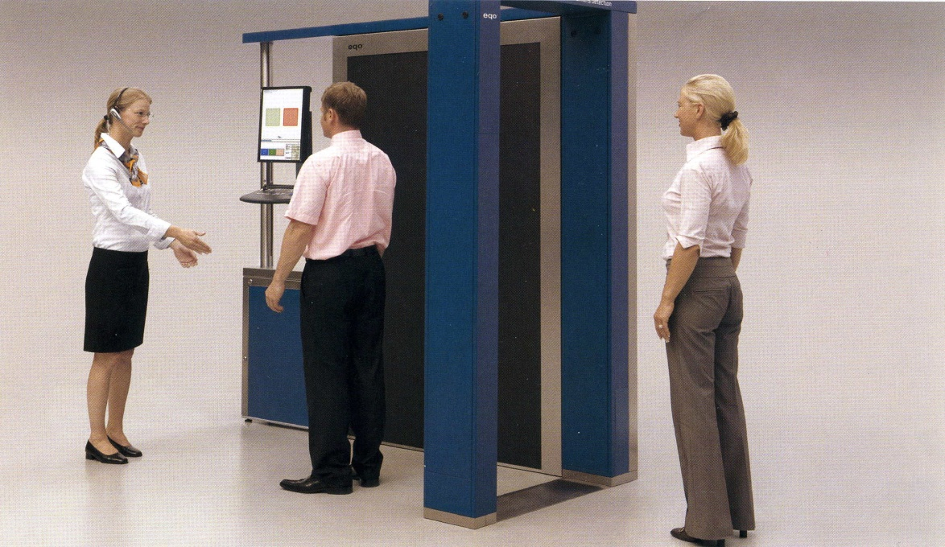
eqoTM _{(Smith Detection)}
The technology of inspection is similar to SafeScout technology (palpation by a bunch of radio waves)
Features:
The beam moves not mechanically, and is generated by the phased antenna lattice
Surveyed has to turn on 360 ° in the course of scanning
Permission is better – 4х4 mm
Shortcomings of SafeScout are kept: the objects swallowed or hidden in body cavities under dense outerwear, in footwear, under a wet or sweaty shirt, under fabric with Lurex, in plaster or an artificial limb aren't visible.

Slide 12
SRK (EVT Anlagenbau GmbH, Austria)
The system is based on use of the getting radiation
The maximum time of scanning – 5s
Permission (the pixel size) – 1х1 mm; 1,5kh1,5mm *
Geometrical distortions are practically absent
Capacity – 2÷3 persons/min.
Dose for one inspection ~ 0,3÷0,5 of μSv **
The movement surveyed during scanning practically
don't influence quality of a picture. There are no inconveniences at all.
At selective examination on installation also examination of hand luggage is possible (option)
* Parameter is defined at the order of installation
** Parameter is set by the user depending on the examination purpose

Slide 13
We will compare properties and characteristics. What system is optimum now?
At once we exclude so-called systems on the return dispersion (SafeScout 100 (USA), Secure 1000 (USA) – low efficiency of examination, inconvenience and humiliation at examination.
Consys, B-500 – radiation of the people standing around, distortions down, inconveniences at inspection (transportation of the person). Quality of a picture – quite good.
HomoScan – a picture "sluggish" because of the low spatial resolution and the increased level of noise. Distortions down. For the rest the system is convenient and safe.
SRK – optimum customs system. The picture is accurate, with high resolution. The system is safe and convenient.

Slide 14
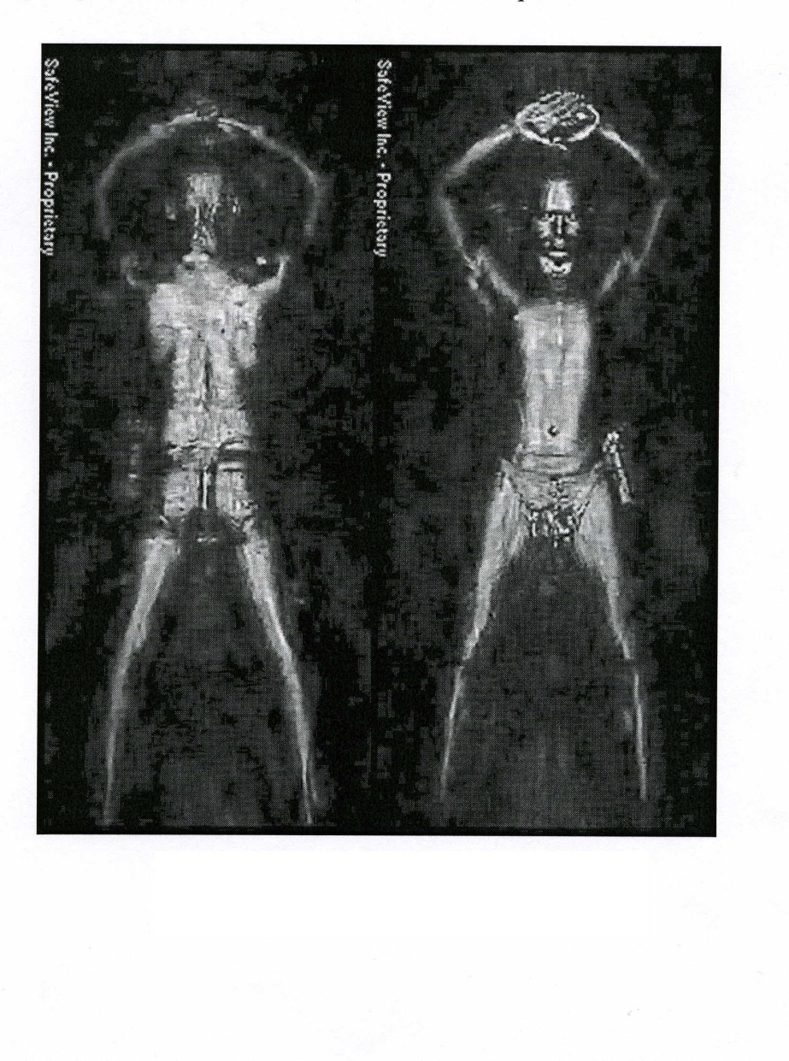
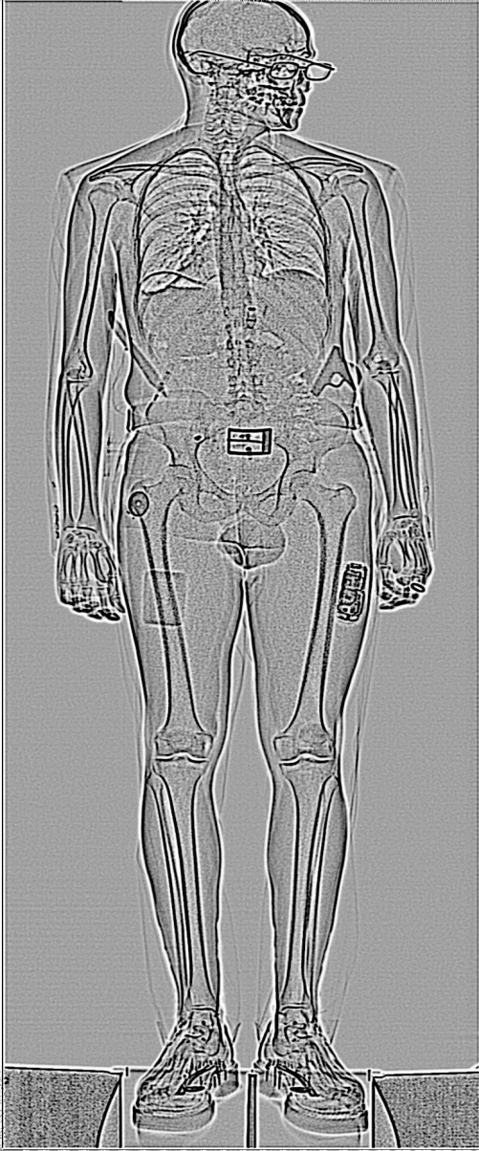
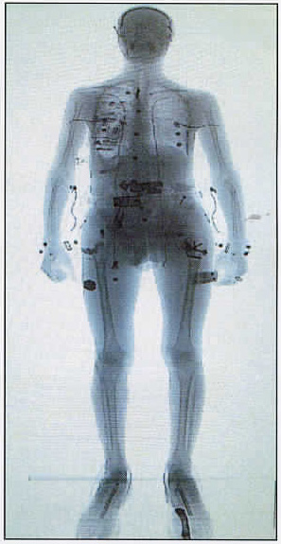
The pictures received on the systems working in the world
SafeScout (США)
SRK (EVT)
Is it possible to hide something?
НомoScan (Russia)

Slide 15
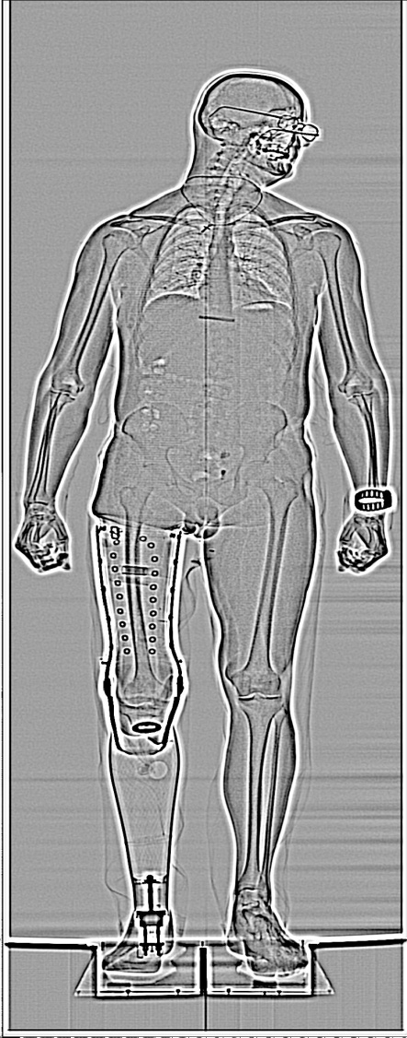
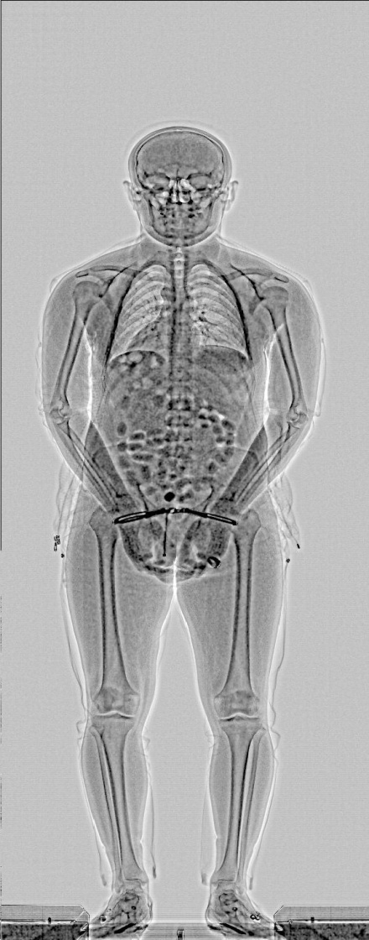
Assessment of opportunities of SRK (EVT)
Three flat pieces of plastic explosive, and also plastic knife are visible
(together with points).
Containers with drugs are well visible
It is visible, there are no investments in an artificial limb

Slide 16
What (and who) prevents broad application of so effective, safe and convenient remedy of personal examination which besides is checked by long operation at the airport of Novosibirsk city (Russia) (to the 3000 people/day)?
The reasons are rather clear:
А. Alignment on technology "with a brand" that induces to buy and use at the airports installations, inefficient and inconvenient for passengers, on millimetric radio waves. The reasons of such choice are unclear. As a justification – artificially propagandized radio phobia.
Б. Insufficient scientific and technical competence of potential consumers of SRK (EVT) – officials and intelligence agencies. Often they can't apprehend evidence-based comparisons of a natural background and doses when using SRK (EVT).

Slide 17
We concretize a situation:
Quastions: Answers:
Application of SRK is effective? Level of safety increases? Yes
Application of SRK is comfortable? Yes
Application of SRK is safe? (The dose is equivalent to 4 minutes of flight) Yes
SRK is checked by long real operation? Yes
What do we see practically at all airports? People continue to feel discomfort and humiliations, but stand them since. It seems to them that it becomes for ensuring their safety. Actually is only visibility of fight for safety. The suicide bomber with a bomb will pass in a rectum in the plane without effort. What do we wait for? Terrorist attack and victims? Why not to make examination more pleasant, and weeds safer already now?
Now, after terrorist attacks in Paris, Ankara, Brussels, Pakistan, Istanbul, explosion of the Russian plane over Sinai, there can come the turn of other countries.

Slide 18
The opponent is ruthless, is present worldwide and is aimed at striking blows on civilians. To wait passively – it is just criminal. It is necessary to work:
1. It is urgent to equip zones of examination of all airports with the SRK installations and to enter obligatory examination on them, without a possibility of the voluntary choice of a way of examination.
2. To clean a framework of metaldetectors on an entrance to a zone of examination. Metal objects by means of SRK are found much better (a form of objects and their arrangement).
3. At preflight examination at the airports of the countries where drugs are produced, by means of SRK becomes possible at the same time to find also the drug traffickers transporting drugs in a body.

Slide 19
4. For prevention of penetration of terrorists on the territory of the airport it is expedient to establish SRK not far from entrances to the airport. To keep the equipment on entrances: metaldetectors and luggage introscopes. For entering on the territory of the airport psychologists and specialists in a profayling have to observe (directly or by means of surveillance cameras). They have to allocate suspects or persons with inadequate behavior and to direct them to examination on SRK. Apparently there will be enough one installation on several entrances.
5. To add SRK with the devices increasing safety level: devices of suppression of signals, devices for detection of radio-electronic components in a body and in baggage, by portable "electronic noses", etc. – such devices are developed and are made by several companies.
Certainly, finally, the list died and the equipment for holding a procedure of examination have to define the relevant structures. But it is necessary to work and to work urgently. It will involve considerable material inputs, but inaction will be more expensive.

